Slide 1
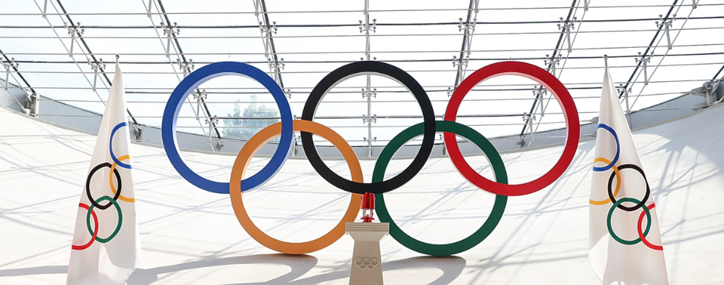
120 Years of Olympic History
CAPSTONE I PROJECT

Slide 2

Capstone I Project
For this assignment, you will be able to choose a set of data on Kaggle or similar and do your own analysis of it! This project is meant to highlight the analysis process as you use multiple languages and platforms to analyze the same set of data. Choosing a Data Set Below, I have added a few common resources for finding data. Some of these websites change regularly. Some of them are not formatted ideally for what we do. Before you choose a set, try and make sure that it is a data set you have the tools to analyze. For example, some soccer data is arranged into graph data, which is not a normal data-analysis format; if there's a tabular or noSQL format, that's more common and will be a better resume piece anyways; so don't try and reinvent the wheel just because you found a cool data set. I recommend you find a topic you like and search elsewhere for similar data sets. Imagine you are working for a business and your boss doesn't understand data. Your mission is to create a report explaining what is going on with the data and what conclusions you have made from the data. (The data set you choose doesn't have to be related to a business at all). Before you start, I want you to write out a hypothesis about the data, even if you have no clue what the data means. You may also add hypotheses as you go and test them - often you will have many, many questions about your data that you'll want to answer. Then, you'll be using R and Python to analyze whatever data you find. I recommend going through the entire process with one language and then trying it with the other. Googling things is totally encouraged if you need to find specific tools for Python or R, particularly if there are specific tools from the tidyverse to help out; this won't be needed for every project. This project is intentionally open-ended, as an important part of data analysis is knowing your data. After you've looked at a lot of the data, you will write a report detailing your process and showing the results of your analyses. For each major hypothesis you look into, you should cover that in the report and include charts, graphs, anything necessary to communicate the data. I am much less concerned with things like grammar and styling and very interested in seeing how you got the conclusions you made in a way that you can explain to someone who doesn't speak data. Have fun with this project! There is no length requirement on the report; I just want to see you communicate well about what you've found and what the data means. I anticipate the project takes around 10 hours; if it takes more or less, that's okay, but you should be very familiar with your data and writing a good report on it. The submission should include all your technical work, and the report itself. Put them all in a GitHub repo and post the repo here. Please book here after submission: https://scheduler.zoom.us/d/tgmpvv4s/data-capstone

Slide 3
120 Years of Olympic History
Initial Olympic History Analysis – 1896 to 2016
Olympic seasons: 51
Summer seasons: 29
Winter seasons: 22
The tables to the right provide the year, season and host city for each Olympics.
Participating countries: 230
Summer season countries: 230
Winter season countries: 119
Participating athletes: 134,731
Summer season athletes: 116,121
Winter season athletes: 18,923
There were 313 athletes who participated in both summer and winter games.

Slide 4
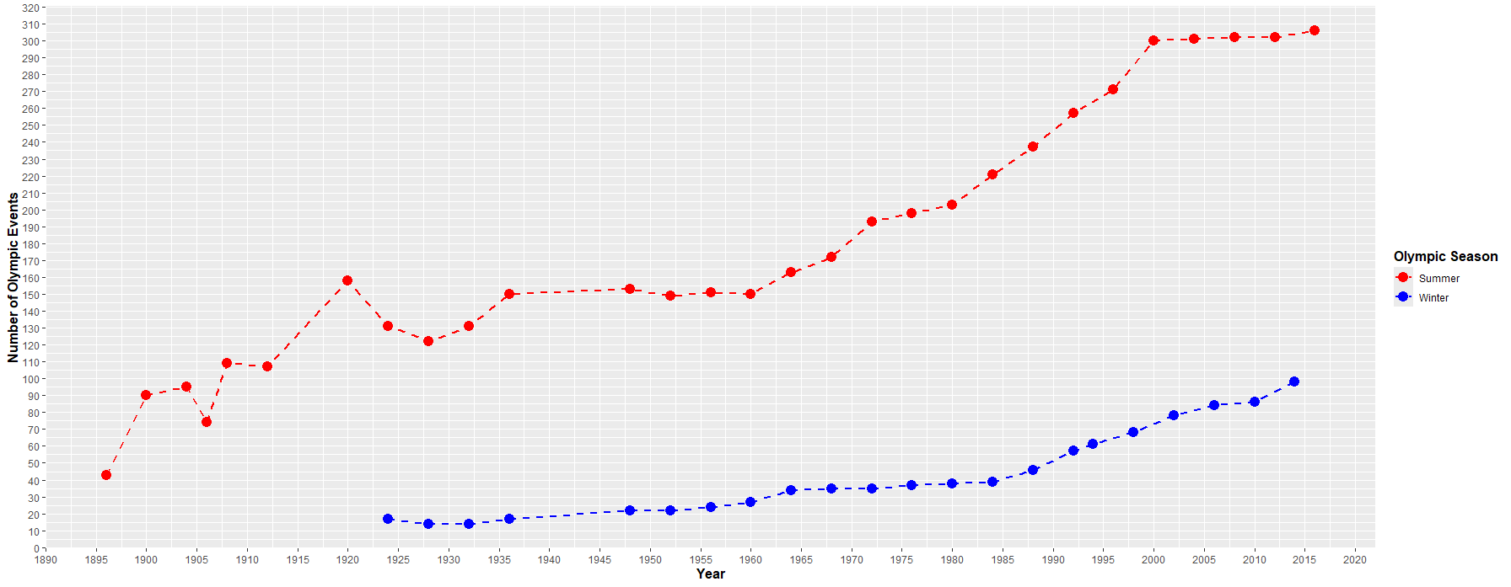
120 Years of Olympic History
Hypothesis # 1: The number of summer and winter events increases each year.
Analysis – Pulled and graphed distinct event counts for each Olympic year, separating summer games from winter.
Findings – The hypothesis was incorrect. The number of events has trended up over time but hasn’t increased each year.

Slide 5
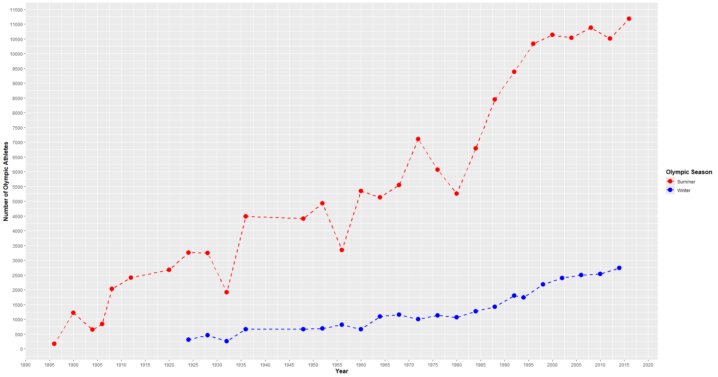
120 Years of Olympic History
Hypothesis # 2: The number of summer and winter athletes increases each year.
Analysis – Pulled and graphed distinct athlete counts for each Olympic year, separating summer games from winter.
Findings – The hypothesis was incorrect. The number of athletes has trended up over time but hasn’t increased each year.
Decrease in athletes in 1932 was due to a worldwide depression. Decreases in 1956 and 1980 were due to countries boycotting the games.

Slide 6
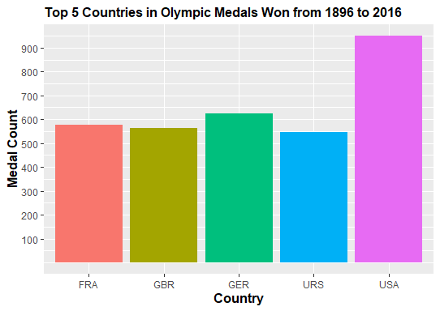
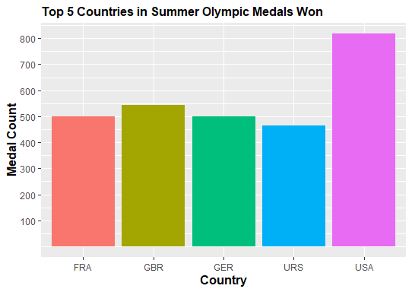
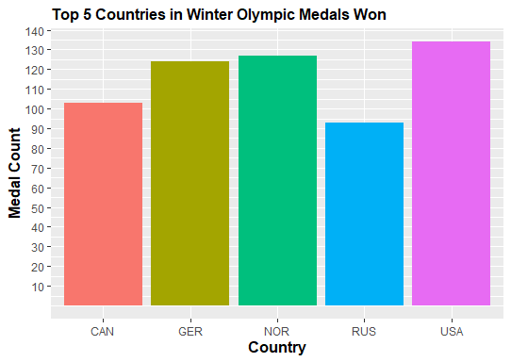
120 Years of Olympic History
Hypothesis # 3: The USA has won the most Olympic medals.
Analysis – Pulled and graphed the number of medals won for the top five countries, total, summer only, and winter only.
Findings – The hypothesis was correct. The USA has won the most total medals, summer medals, and winter medals.

Slide 7
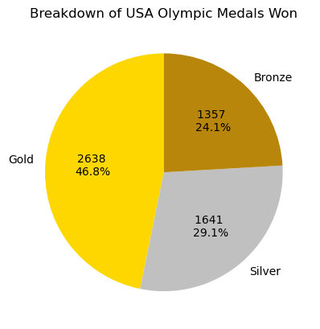
120 Years of Olympic History
Hypothesis # 4: Of all Olympic medals won by the USA, a third are gold, a third silver, and a third bronze.
Analysis – Pulled the counts of all gold, silver, and bronze medals won by the USA and graphed them in a pie chart.
Findings – The hypothesis was incorrect. Of all medals won by the USA 47% have been gold, 29% silver, and 24% bronze.

Slide 8
120 Years of Olympic History
Hypothesis # 5: There are at least ten countries who have never won an Olympic medal.
Analysis – Pulled list of countries having participated in the Olympics and compared it to a list of those with no medals.
Findings – The hypothesis was correct. 81 countries have participated in the Olympics and never won a medal.
['CHA', 'NCA', 'LBA', 'PLE', 'COM', 'BRU', 'MDV', 'YAR', 'CGO', 'BEN', 'SOM', 'MLI', 'ANG', 'BAN', 'ESA', 'HON', 'TKM', 'SEY', 'MTN', 'SKN', 'VIN', 'LBR', 'PLW', 'ASA', 'SAM', 'RWA', 'DMA', 'MLT', 'GUI', 'BIZ', 'YMD', 'SLE', 'PNG', 'YEM', 'OMA', 'VAN', 'IVB', 'CAF', 'MAD', 'MAL', 'BIH', 'GUM', 'CAY', 'GBS', 'TLS', 'COD', 'SMR', 'LAO', 'ROT', 'CAM', 'SOL', 'CPV', 'CRT', 'GEQ', 'BOL', 'SAA', 'AND', 'ANT', 'LCA', 'FSM', 'MYA', 'MAW', 'RHO', 'STP', 'GAM', 'COK', 'ALB', 'SWZ', 'BUR', 'NBO', 'ARU', 'NRU', 'VNM', 'BHU', 'MHL', 'KIR', 'UNK', 'TUV', 'NFL', 'SSD', 'LES']
Hypothesis # 6: There are at least fifty countries who have never won an Olympic gold medal.
Analysis – Pulled list of countries having participated in the Olympics and compared it to a list of those with a gold medal.
Findings – The hypothesis was correct. 121 countries have participated in the Olympics and never won a gold medal.
['CHA', 'SUD', 'NCA', 'KUW', 'IRQ', 'UAR', 'LIB', 'QAT', 'MAS', 'ERI', 'TAN', 'LBA', 'DJI', 'PLE', 'COM', 'BRU', 'KSA', 'MDV', 'YAR', 'PHI', 'KGZ', 'CGO', 'MON', 'ISV', 'SRI', 'BEN', 'GHA', 'SOM', 'NIG', 'MLI', 'AFG', 'GUY', 'PAR', 'ANG', 'BAN', 'ESA', 'HON', 'TKM', 'MRI', 'SEY', 'MTN', 'SKN', 'VIN', 'LBR', 'PLW', 'TOG', 'NAM', 'AHO', 'ISL', 'ASA', 'SAM', 'RWA', 'DMA', 'MLT', 'CYP', 'GUI', 'BIZ', 'YMD', 'BER', 'SLE', 'PNG', 'YEM', 'OMA', 'VAN', 'MDA', 'GUA', 'IVB', 'CAF', 'MAD', 'MAL', 'BIH', 'GUM', 'CAY', 'BAR', 'GBS', 'TLS', 'COD', 'GAB', 'SMR', 'LAO', 'BOT', 'ROT', 'CAM', 'SOL', 'SEN', 'CPV', 'CRT', 'GEQ', 'BOL', 'SAA', 'AND', 'ANT', 'LCA', 'FSM', 'MYA', 'MAW', 'ZAM', 'RHO', 'STP', 'MKD', 'BOH', 'TGA', 'MNE', 'GAM', 'COK', 'ALB', 'WIF', 'SWZ', 'BUR', 'NBO', 'ARU', 'NRU', 'VNM', 'BHU', 'MHL', 'KIR', 'UNK', 'TUV', 'NFL', 'SSD', 'LES']

Slide 9
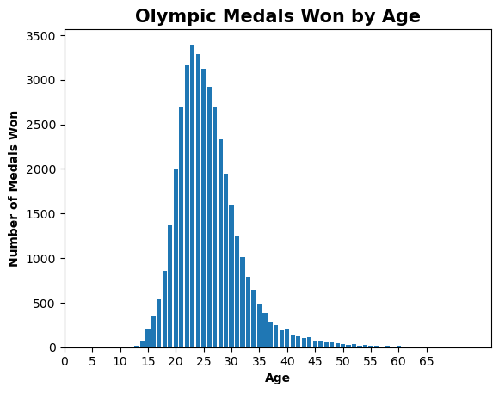
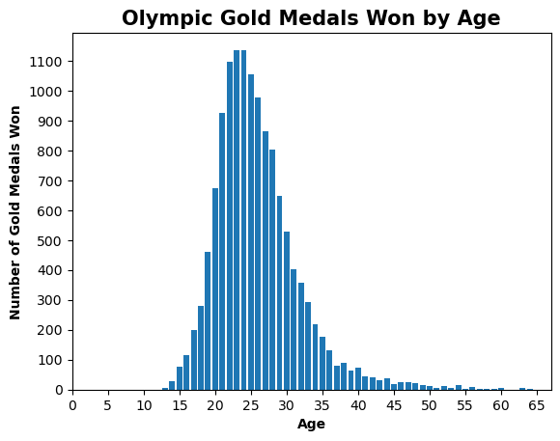
120 Years of Olympic History
Hypothesis # 7: Most medal winners will be 25-30 years old.
Analysis – Pulled and graphed the age of all medal winners; also graphed the age of all gold medal winners.
Findings – The hypothesis was incorrect. The majority of medal, and gold medal winners, has been by 20-25 year olds.

Slide 10
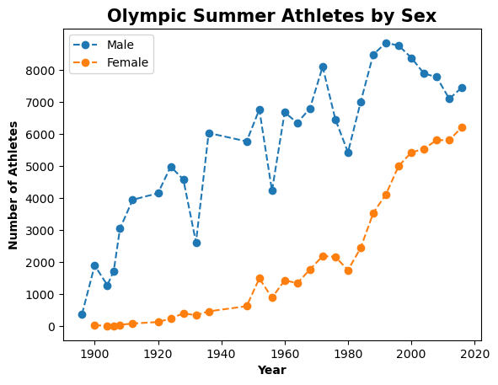
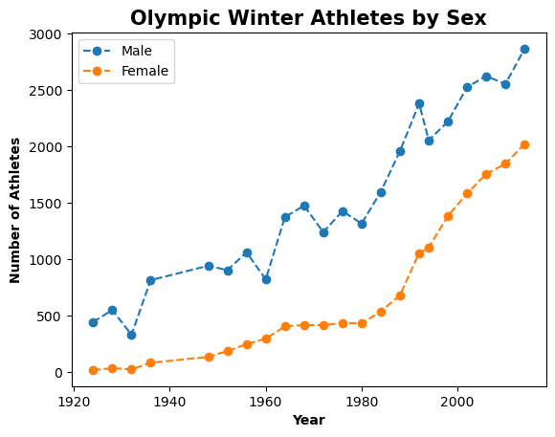
120 Years of Olympic History
Hypothesis # 8: The total number of male and female Olympics athletes will follow a similar increasing trend.
Analysis – Pulled and graphed the count of male and female athletes by year, separating summer and winter seasons.
Findings – Hypothesis was incorrect. Overall, the trend was similar except for three years when male numbers were down.
Decrease in athletes in 1932 was due to a worldwide depression. Decreases in 1956 and 1980 were due to countries boycotting the games.

